Slide 1
Ten Critical Decisions

Slide 2
Ten Critical Decisions
Managing QCD
Design of goods and services
Process and Capacity design
Location strategies
Layout strategies
Human resources
Supply-chain management
Inventory management
Scheduling
Maintenance/Continuous Improvement
Designing Operations
Managing Operations
Notes:
18

Slide 3
The Critical Decisions
QCD management
  Who is responsible for quality?
  How do we define quality?
  How do we reduce cost?
  How do we compress response time?
Goods and services design
  What product or service should we offer?
  How should we design these products and services?
Notes:
19

Slide 4
The Critical Decisions - continued
Process and Capacity design
  What processes will these products require and in what order?
  What equipment and technology is necessary for these processes?
Location
  Where should we put the facility
  On what criteria should we base this location decision?
Notes:
20

Slide 5
The Critical Decisions - continued
Layout design
  How should we arrange the facility?
  How large a facility is required?
Human resources and job design
  How do we provide a reasonable work environment?
  How much can we expect our employees to produce?
Notes:
21

Slide 6
The Critical Decisions - continued
Supply chain management and JIT “Just-in-time” Inventory, Material Requirements Planning
  Should we make or buy this item?
  Who are our good suppliers and how many should we have?
  How much inventory of each item should we have?
  When do we re-order?
Notes:
22

Slide 7
The Critical Decisions - continued
Immediate, short term, and project scheduling
  Is subcontracting production a good idea?
  Are we better off keeping people on the payroll during slowdowns?
Maintenance
  Who is responsible for maintenance?
  What type of preventive/predictive maintenance programs we need?
Notes:
23

Slide 8
New Challenges in OM
From To
Local or national focus
Batch shipments
Low bid purchasing
Lengthy product development
Standard products
Job specialization
Global focus
Just-in-time
Supply chain partnering
Rapid product development
Mass customization
Empowered employees
Notes:
30

Slide 9
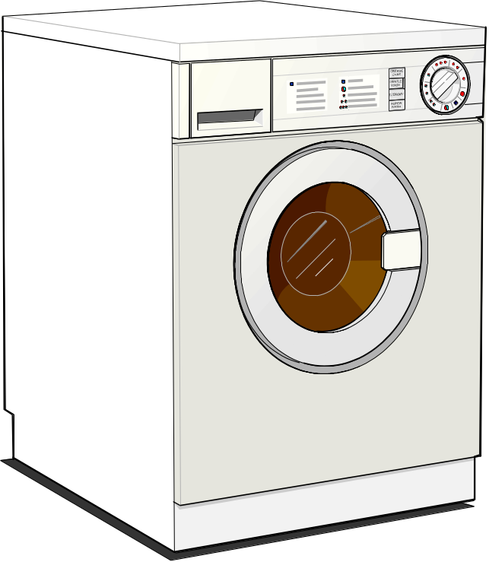
Characteristics of Goods
Tangible product
Consistent product definition
Production usually separate from consumption
Can be inventoried
Low customer interaction
© 1995 Corel Corp.
Notes:
31

Slide 10

Characteristics of Service
Intangible product
Produced & consumed at same time
Often unique
High customer interaction
Inconsistent product definition
Often knowledge-based
Frequently dispersed
Notes:
32

Slide 11
Goods versus Services
Good Service
Can be resold
Can be inventoried
Some aspects of quality measurable
Selling is distinct from production
Reselling unusual
Difficult to inventory
Quality difficult to measure
Selling is part of service
Notes:
33

Slide 12
Goods versus Services
Good Service
Product is transportable
Site of facility important for cost
Often easy to automate
Revenue generated primarily from tangible product
Provider, not product is transportable
Site of facility important for customer contact
Often difficult to automate
Revenue generated primarily from intangible service.
Notes:
34

Slide 13
Productivity
Measure of process improvement
Represents output relative to input
Productivity increases improve standard of living
From 1889 to 1973, U.S. productivity increased at a 2.5% annual rate
Units produced
Productivity
=
Input used
Notes:
37

Slide 14
Typical Cost Structure
Variable Overhead Costs
Controllable Costs
  Labor- Direct/Indirect
  Material- Boxes, Tape, Resin, Labels, Staples, Stretch Wrap
  Maintenance Costs
  Electricity- Extruder/Head/Nozzle Heaters, Lights, Grinders, Conveyors, Battery Chargers
Overhead
Costs
Variable
Fixed
Fixed Overhead Costs
Units Produced
Depreciation Costs on the Books
  Plant
  Property
  Equipment

Slide 15
Productivity Variables
Productivity =
Output
Labor + Material+ Energy+ Capital+Miscellaneous
Notes:
38

Slide 16
Measurement Problems
Quality may change while the quantity of inputs and outputs remains constant.
External elements may cause an increase or decrease in productivity.
Precise units of measure may be lacking
Notes:
39

Slide 17
Productivity Variables
Labor - contributes about 1/6 of the annual increase
Capital - contributes about 1/6 of the annual increase
Management - contributes about 2/3 of the annual increase
Notes:
40

Slide 18
The Economic System Transforms Inputs to Outputs
Inputs
Process
Outputs
Land, Labor, Capital, Management
The economic system transforms inputs to outputs at about an annual 1% increase in productivity (capital 1/6 of 1%, labor (1/6 of 1%, management (2/3 of 1%)
Goods and Services
Feedback loop
Notes:
35

Slide 19
Key Variables for Improved Labor Productivity
Basic education appropriate for the labor force
Health of the labor force
Social overhead that makes labor available
Maintaining and enhancing skills in the midst of rapidly changing technology and knowledge
Notes:
41

Slide 20
Service Productivity
Typically labor intensive
Frequently individually processed
Often an intellectual task performed by professionals
Often difficult to mechanize
Often difficult to evaluate for quality
Notes:
46

Slide 21
What is Due Next Week?
“Quality costs money.” Write a one page (double spaced) discussion on merits of this statement clearly stating your case with supporting arguments.
What do you understand by productivity and how can it be improved in a manufacturing factory? Write a one page (double spaced) discussion.

